Slide 1
Green Solutions in Shipping
Sandro Vidas, mag. oec.
CSA Mare Nostrum
7. March 2018
Zagreb

Slide 2
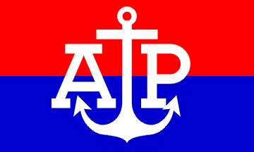
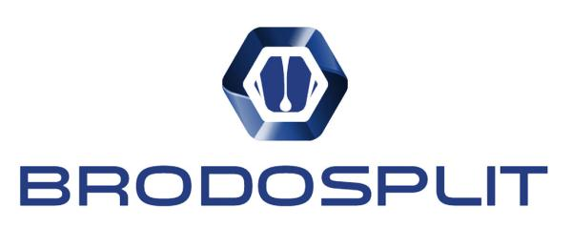
Croatian Shipowners’ Association Mare Nostrum
Founded 5. February 1991
10 members, 138 ships, 1.74 mil. GT
ECSA

Slide 3
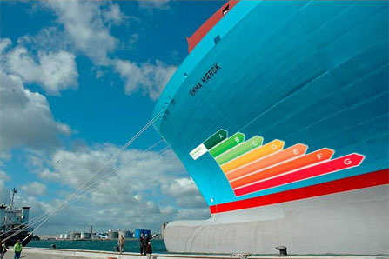
1. International Shipping Standards
The International Convention for the Prevention of Pollution from Ships, 1973 MARPOL
Sulphur Cap 2020
NOx Tier III Standard
International Convention for the Control and Management of Ships' Ballast Water and Sediments (BWM)
EU MRV Regulation, (Monitoring, Reporting, Verification) 2015/757
International Convention on the Control of Harmful Antifouling Systems on Ships, 2001 (AFS Convention)

Slide 4
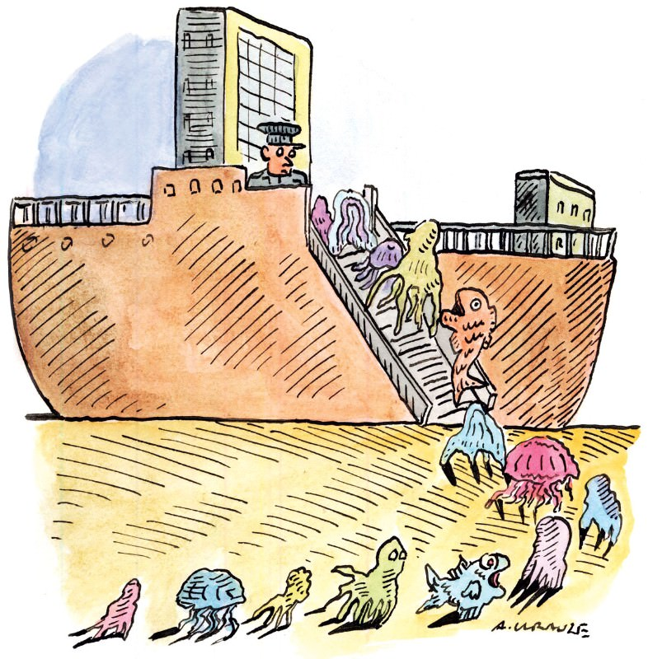
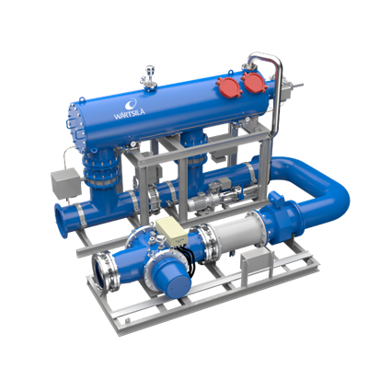
BWM - U.S.C.G. approved
Manufacturer | Method | Pump Capacity
Alfa Laval | Filtration/Ultraviolet | 85 - 3000 m3/h
Ecochlor | Filtration/Chemical Injection | 500 - 16200 m3/h
Ocean Saver | Filtration/Electrodialysis | 200 - 7200m3/h
Optimarin | Filtration/Ultraviolet | 167 - 3000 m3/h
Sunrui | Filtration/Electrolysis | 170 - 8500 m3/h
ERMA first | na | 90 – 3740 m3/h

Slide 5
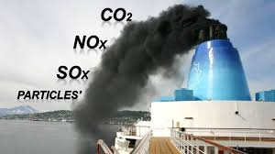
Global Sulphur Cap 2020

Slide 6
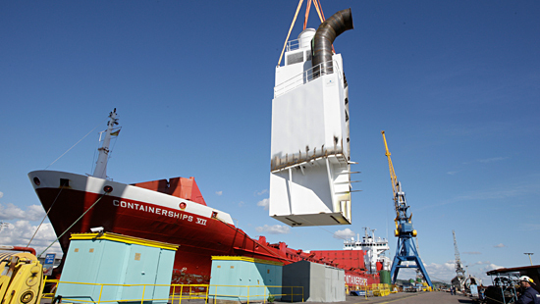
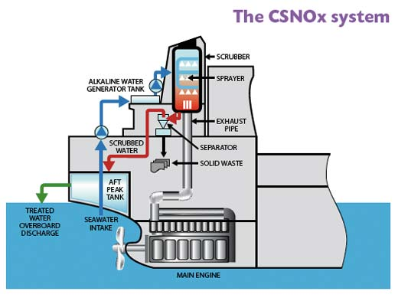
Scrubbers
Price for one scrubber: 2 – 2.5 mil. USD

Slide 7
2. Shipbuilding 2018 – 2023
Ship type | Number of ships | Price per ship
1. Dry bulk
40.000 DWT | 2 | $25,000,000.00
65.000 DWT | 4 | $26,000,000.00
2. Liquid cargo
52.000 DWT | 3 | $32,000,000.00
3. Passenger | 14 | $11,000,000.00
Total | 23 | $404,000,000.00

Slide 8
Hybrids and LNGs
LNG RO RO
Damen ASD TUG 2810
electricity and diesel

Slide 9
Hybrids and LNGs
LNG RO RO
LNG Passenger Ship

Slide 10
Scandlines

Slide 11
LNG bunkering – ports of Rijeka, Ploče and Vukovar
Port bunkering
LNG Bunkering Vessel

Slide 12
LNG Barge and Cold Ironing – ports of Split and Dubrovnik
Hummel LNG Barge
Cruise Ports

Slide 13
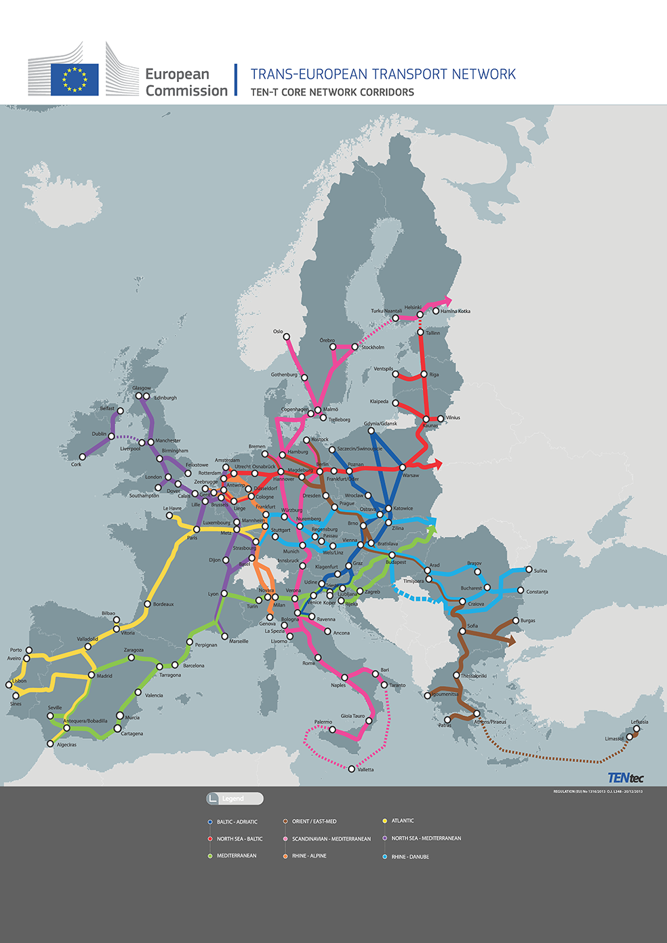
3. Motorways of the Sea examples and working material
LIMITS
Only for Short Sea Shipping
Ships in International Shipping?
Only 1 Core Port – Rijeka
Shipowners would like to improve the overall performance of its fleet and not only the performance of ships operating on the Core network

Slide 14
MoS Pillar I – Deployment of alternative clean fuels and green shipping
Technologies reducing CO2 (climate change)
Facilities for LNG, methanol and other clean fuels in ports and aboard
vessels incl. bunkering barges
Technologies reducing NOx emissions
On-shore power supply systems for ships
Batteries (fuel cell)
Energy efficiency measures on ships (hull, propellers, re-blading etc)
Facilities for oil and other ship waste in ports
Facilities for sludge from scrubbers
Waste water treatment systems on ships
Ballast water treatment systems

Slide 15
MoS Pillar II - Port infrastructure development & upgrade of maritime links
Develop the port infrastructure, handling facilities, freight terminals, logistic platforms and freight villages together with improved port access
Develop reliable short sea shipping transport services integrated within door-to-door logistics chains and connecting core network corridors
Improve logistics and administrative ICT management systems
Increase safety and security during port handling operations
Increase the environmental performance of ships on dedicated MoS links

Slide 16
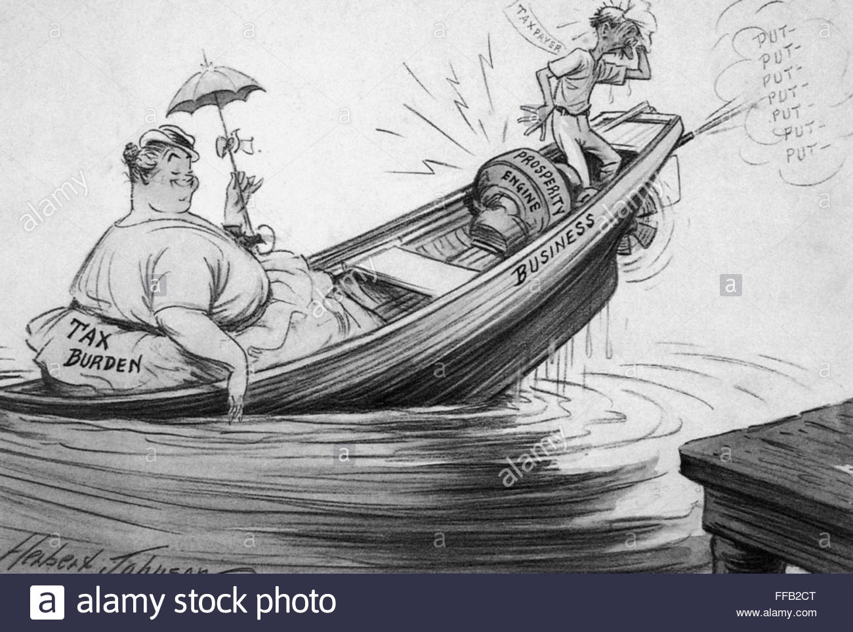
Plans for fleet renewal?
Public procuremement vs State Aid
Croatian Shipowners in Tonnage Tax
Tax payed even if the ships are not operating
No State Aid allowed
Not calling EU ports

Slide 17
Mare Liberum
Croatian Shipowners’ Association Mare Nostrum
Zagreb, 2018

